Slide 1
Construction Site Pedestrian Simulation with Moving Obstacles
Ingrid Ibarra
Ricardo Vásquez
Giovanni Filomeno

Slide 2
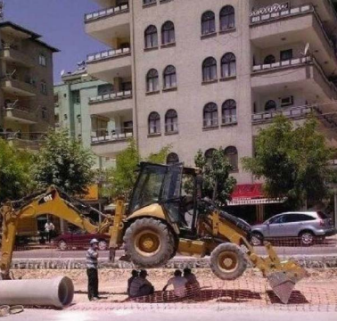
Setting
Current pedestrian simulation don’t consider moving obstacles.
Moving obstacles follow predefined paths.
Workers must avoid areas near the machines.
Task
Develop a software for pedestrian and moving obstacles interactions.
Define paths for moving obstacles.
Visualize the results.
[1]

Slide 3
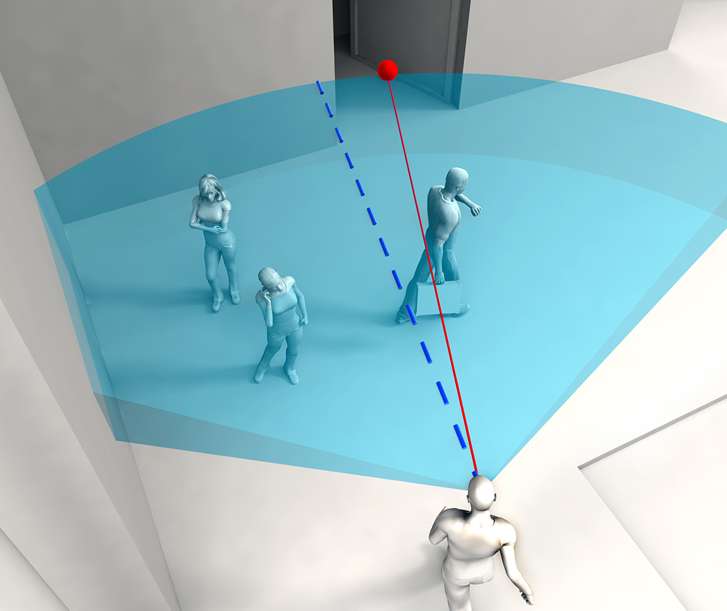
Requirements and specifications
Scenario with several objects
Moving objects
Create a provisional-path finding algorithm
Obstacle avoidance algorithm
„Safety areas“ in moving obstacles
Algorithm to avoid obstacles and define a path
Visualize objects and pedestrians
[2]

Slide 4
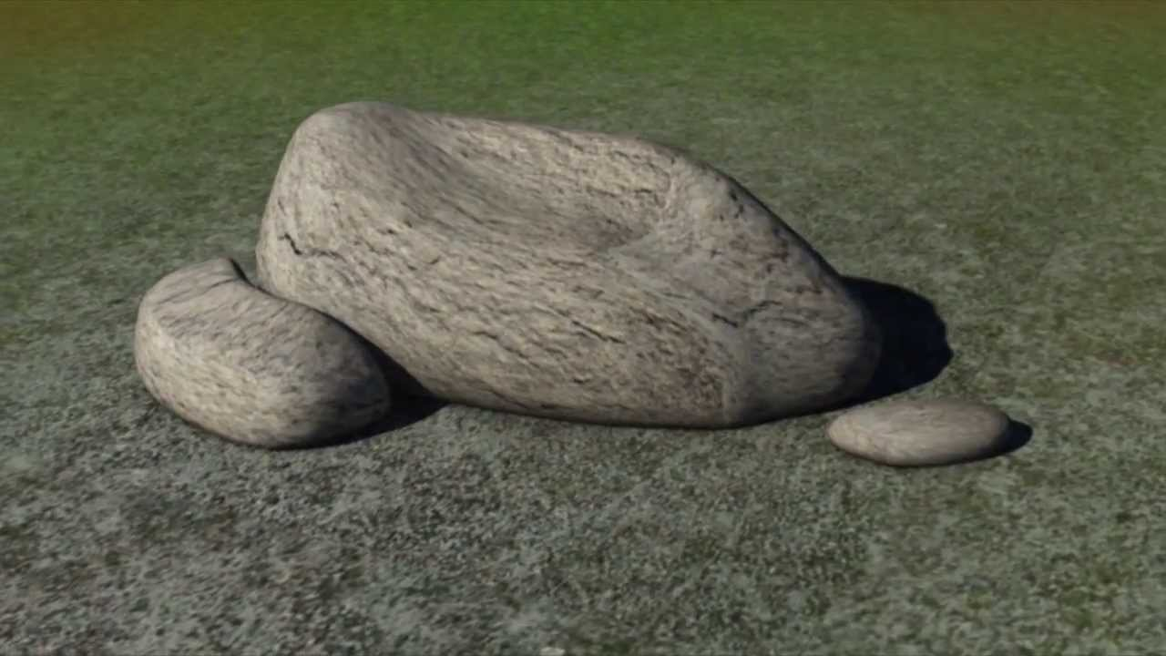
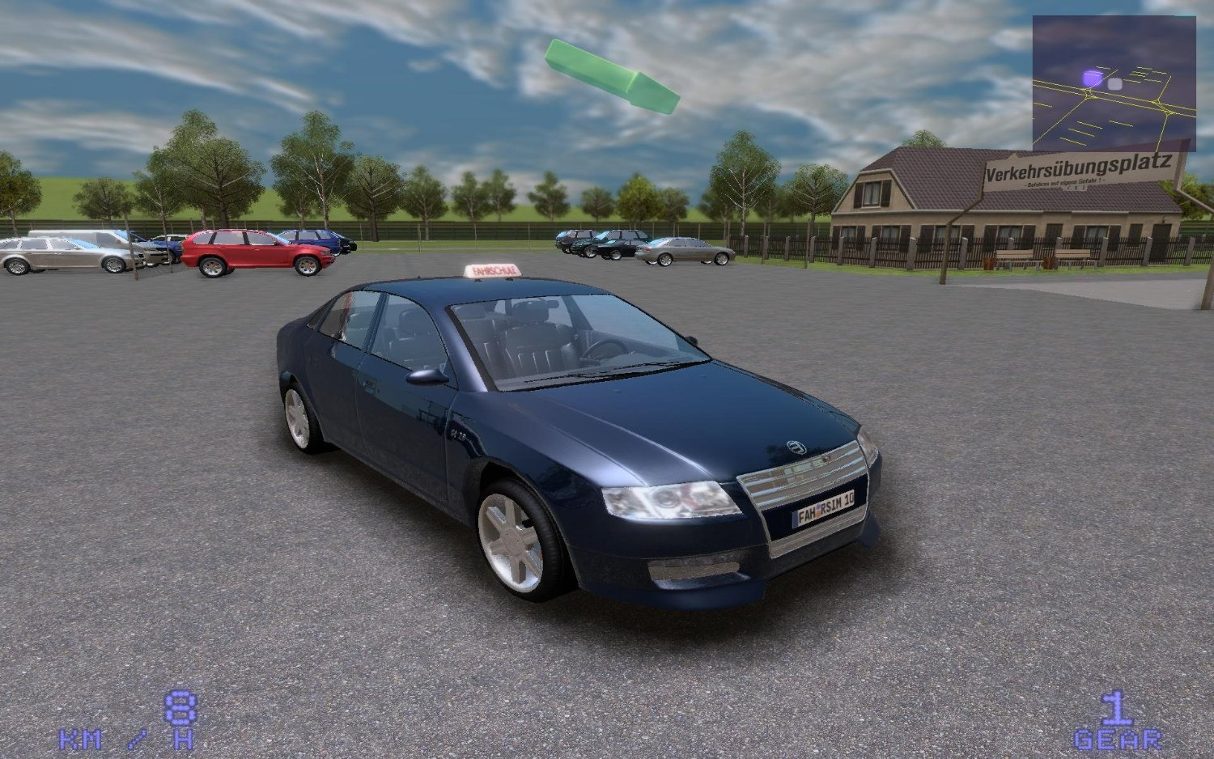
Fixed and Moving Obstacles Concept of safety area
[3]
[4]

Slide 5
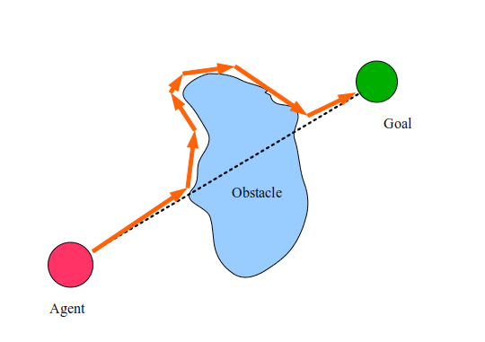
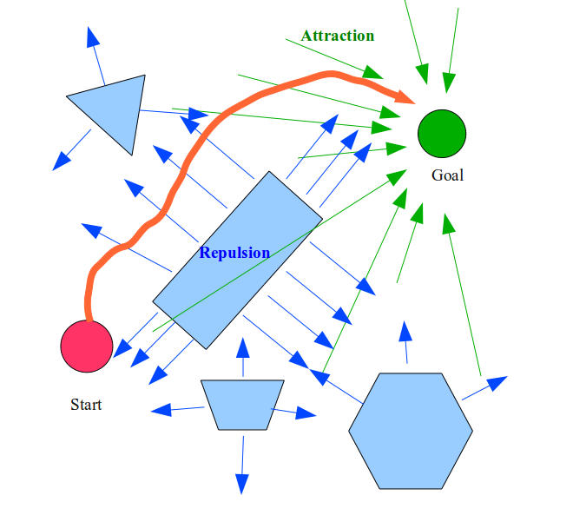
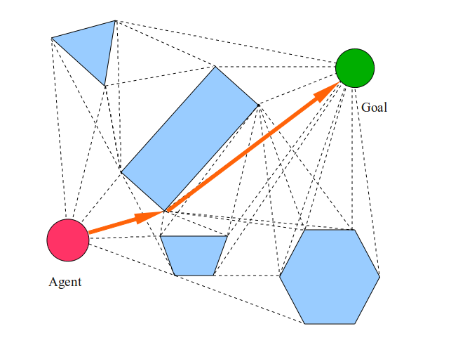
Research
Visibility graph
Bug algorithms
Potential Fields
[5]

Slide 6
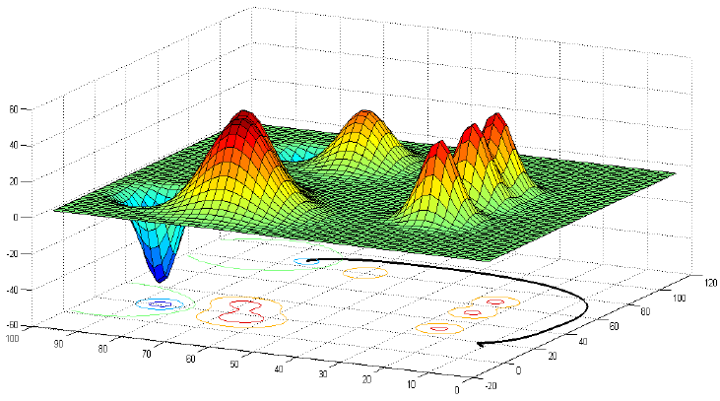
Solution proposal: Potential Fields
Repulsive
Potential Field
Attractive
Potential Field
F
O
3D representation of potential fields
Final point
Obstacle
[6]

Slide 7
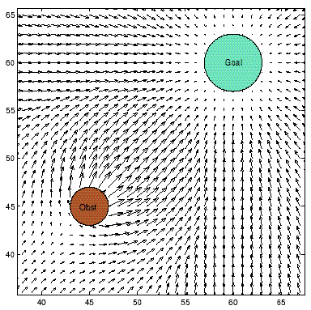
Sum of fields
At each point or the grid, there will be a unique force equivalent to the sum of gradients from sources and sinks
GOAL
Pure Attractive field
Goal
Obst
Attraction + repulsion
Obstacle
Obstacle
Attraction + repulsion
Local Path Planning Using Virtual Potential Field, Hani Safadi
[7]

Slide 8

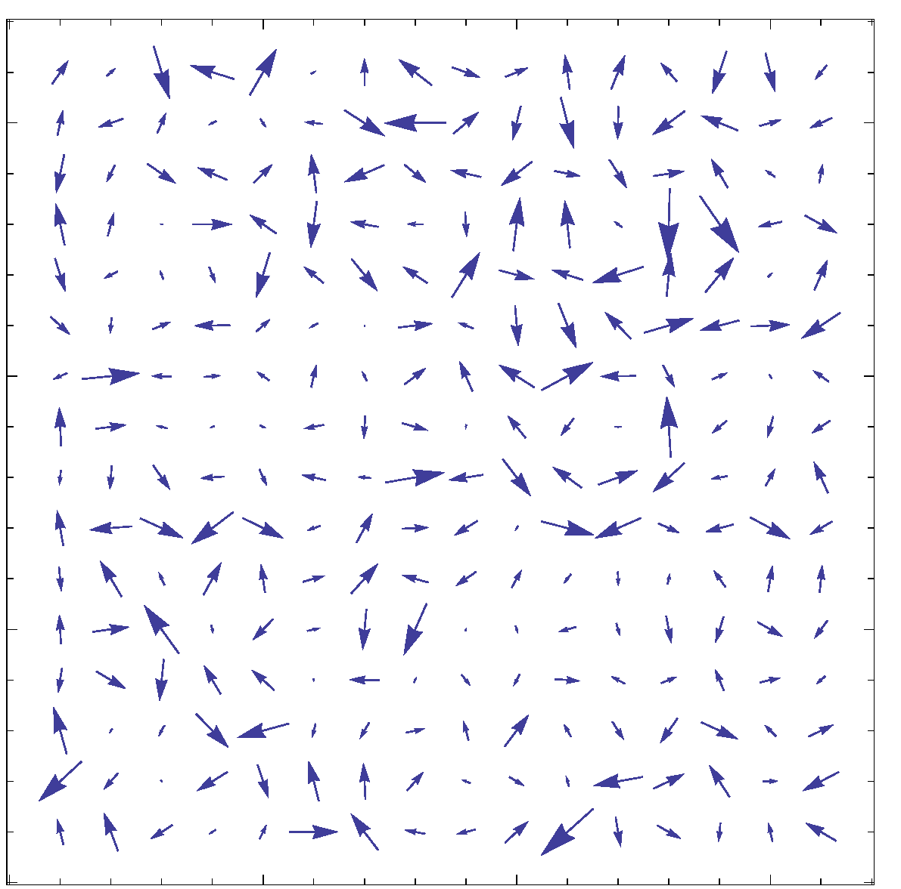
Solution to local zero:
Adding a rotational field around obstacles
Breaks symmetry
Avoids some local minima
Guides robot around groups of obstacles
A random field gets the robot unstuck.
Avoids some local minima.
[8]

Slide 9
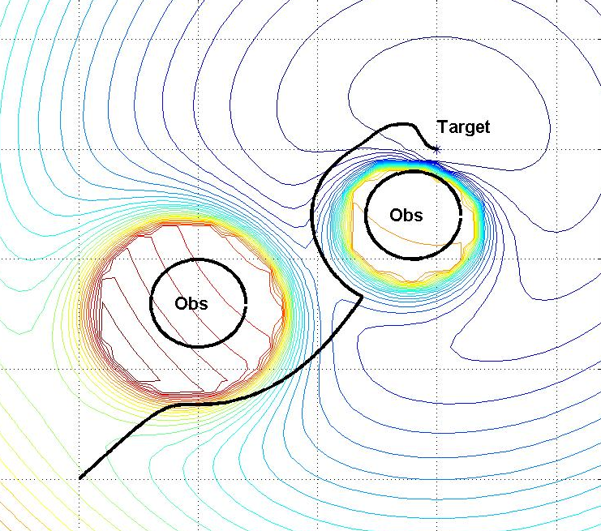
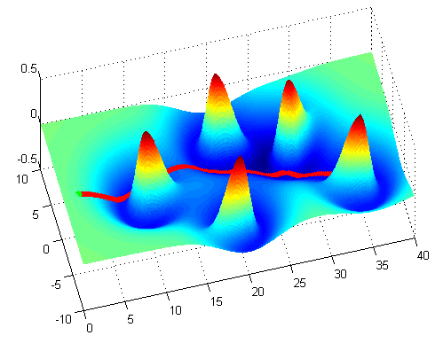
Resulting Robot Trajectory
For every point the path will be given from the sum of forces
[9]

Slide 10
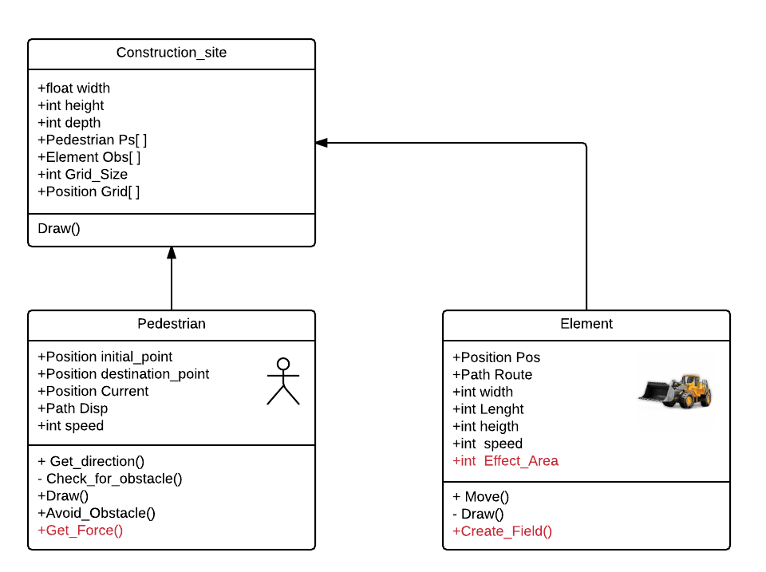
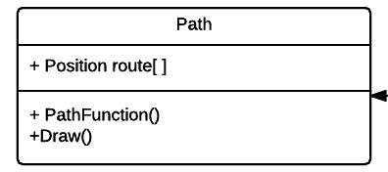
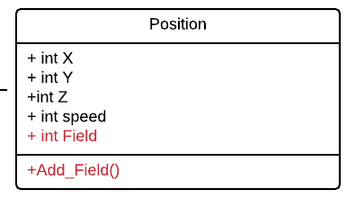
UML Diagram

Slide 11

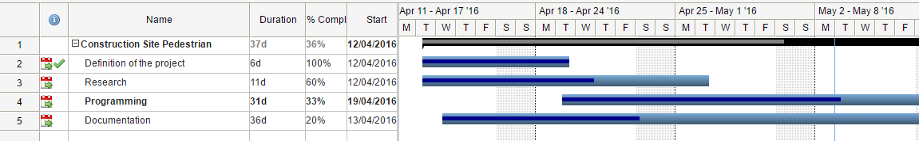
Current status
The potential field will be applied
The program is being developed in C#
The main classes are already implemented
The behaviour and the visualization are independent
The first visualization is considered in 2D
[10]

Slide 12


Slide 13
References
[1] http://www.cie.bgu.tum.de/upload/lehre/softwarelab/sl2016/
[2] http://www.mehdimoussaid.com/archives/53
[3] https://i.ytimg.com/vi/Q4Nh03JnbqI/maxresdefault.jpg
[4] http://www.hixxysoft.com/Images/driving-simulator-2013-pc-game-2.jpg
[5] http://www.gamasutra.com/blogs/MattKlingensmith/20130907/199787/Overview_of_Motion_Planning.php
[6] https://www.researchgate.net/figure/224929429_fig9_Fig-14-Artificial-potential-field-and-the-obtained-path-with-minimum-risk
[7] http://www.cs.mcgill.ca/~hsafad/robotics/
[8] http://phoenix.goucher.edu/~jillz/cs325_robotics/goodrich_potential_fields.pdf
[9] http://www.control.aau.dk/~ms/phd
[10] https://www.visualstudio.com/

Slide 14

Questions?

